Slide 1
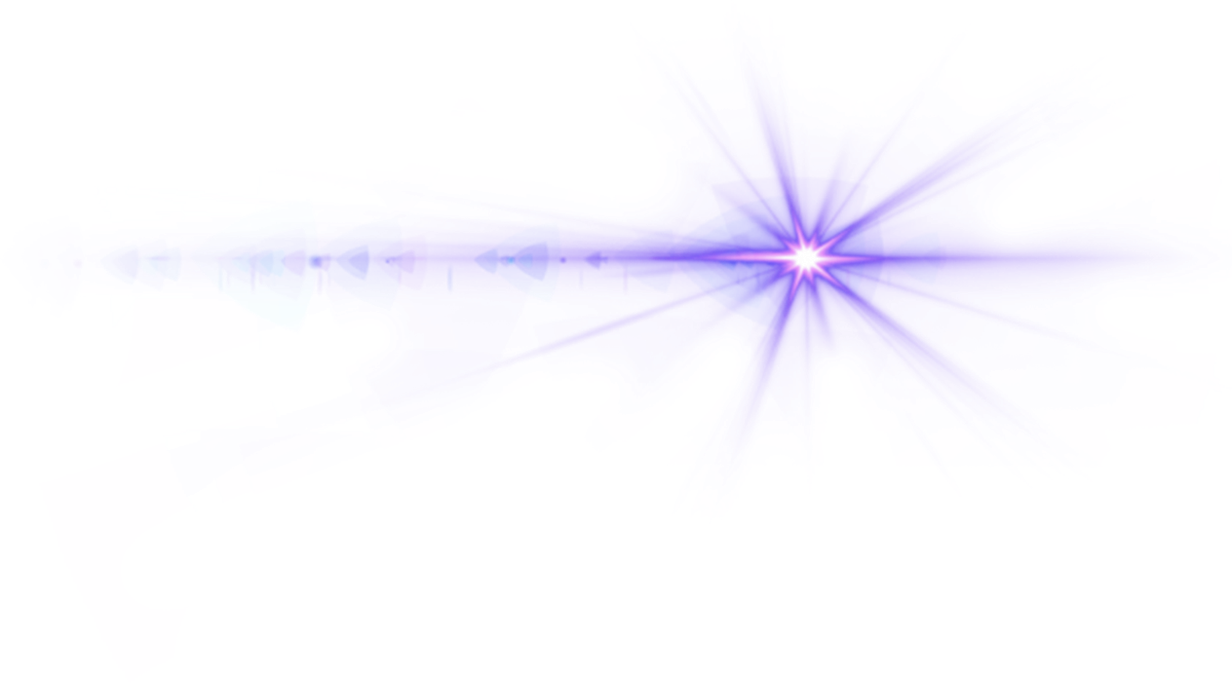

AI-Based OMR Sheet Evaluation

Slide 2
Contents
Methodology
Conclusion
Introduction
Feasibility
02
01
03
04

Slide 3


Introduction
The system takes scanned or photographed OMR images, determines where each bubble should appear using a geometric template and optional perspective calibration, and extracts small image regions around every option. A convolutional neural network built with transfer learning on a lightweight backbone (such as MobileNetV2) then classifies whether each bubble is marked, which is more robust than relying only on simple pixel counts. The predicted answers are compared against a CSV answer key matched by Image_ID, and the tool reports accuracy, marks, confidence, and flags for ambiguous cases (for example multiple marks or low confidence). Supporting scripts handle training and batch evaluation, while a Streamlit web interface provides an interactive way to upload sheets, inspect results, and download outputs. Together, these pieces show how classical OpenCV-based processing and modern deep learning can be combined into a complete, practical tool for automated objective grading.
Notes:
https://unsplash.com/photos/RvPDe41lYBA

Slide 4

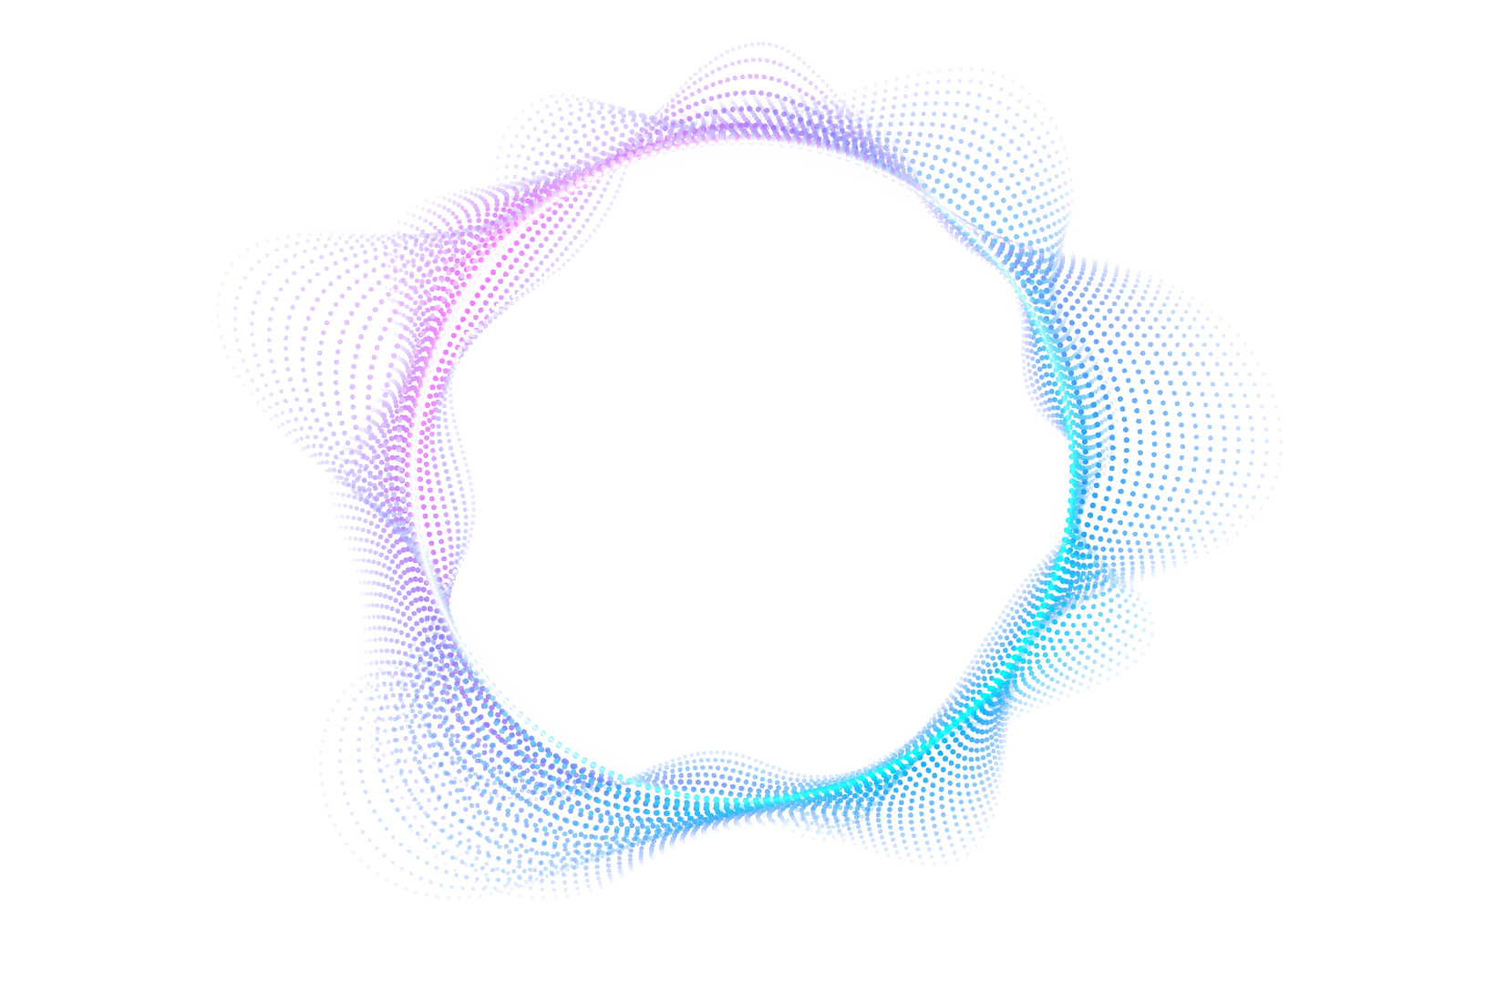
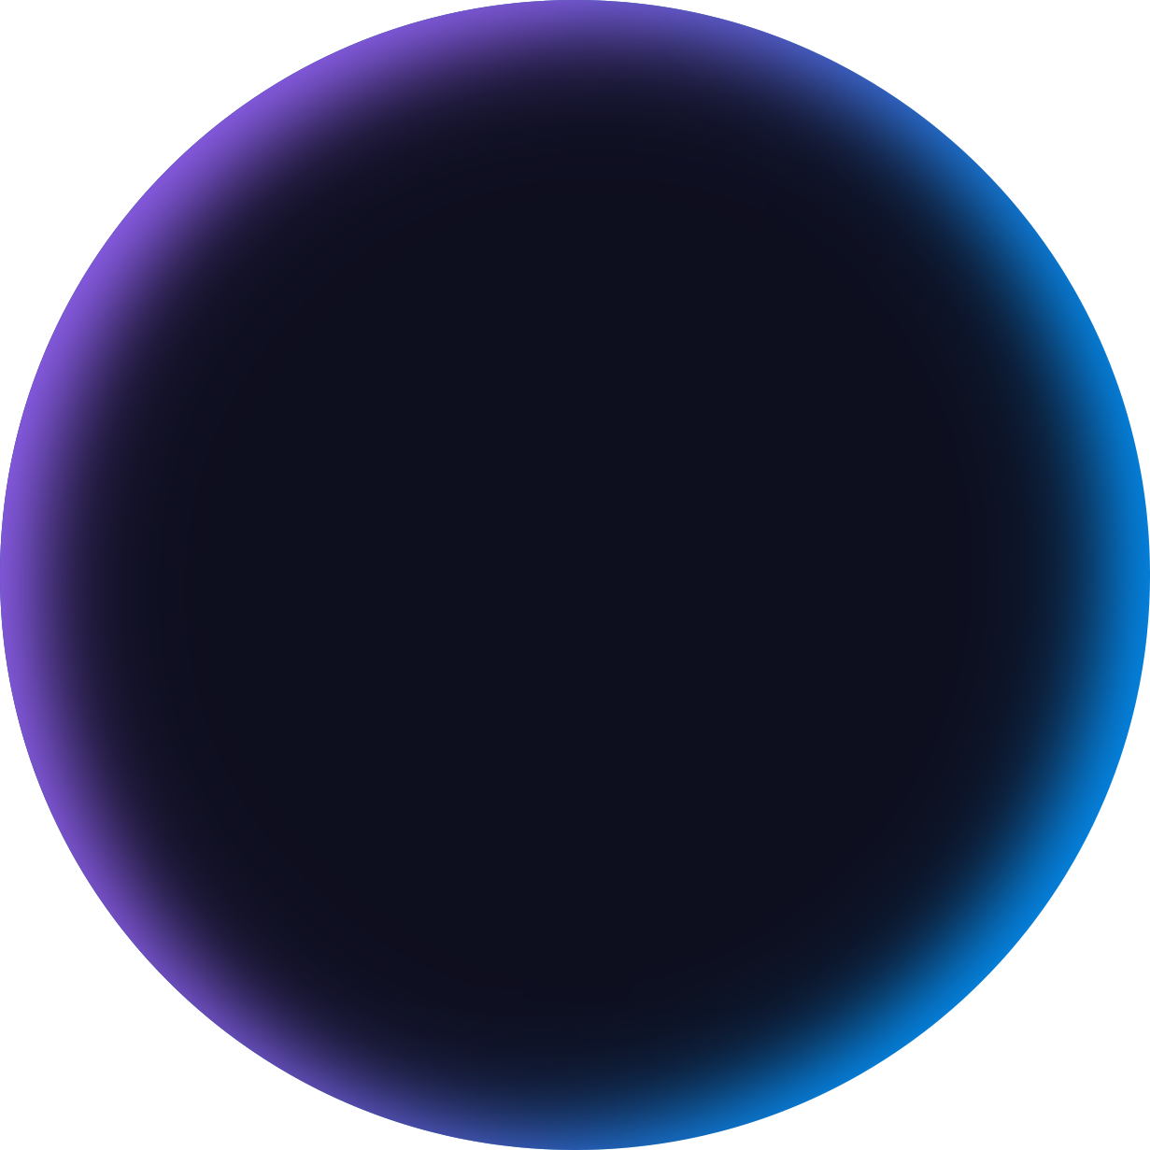
Methodology
Image Preprocessing
CNN Classification
Template Alignment
Answer Grading

Slide 5
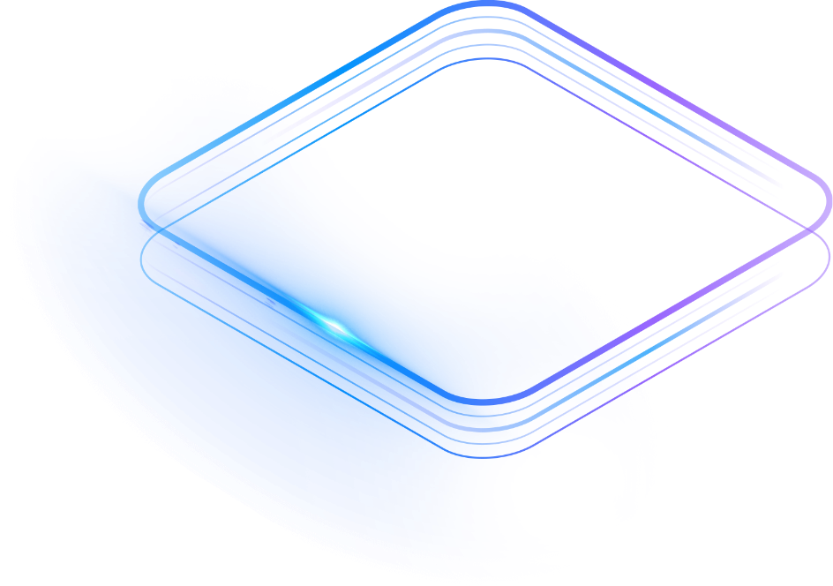
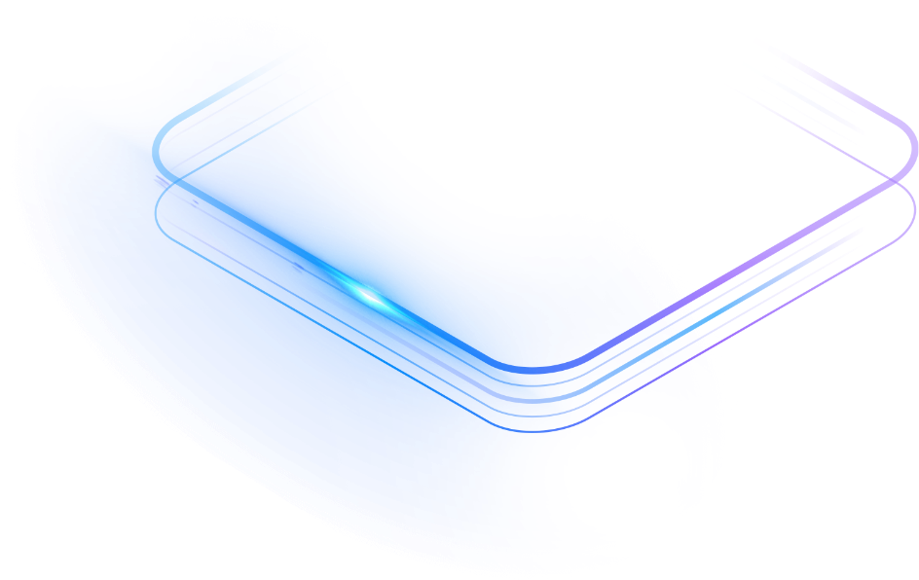
Feasibility
Mature OpenCV + TensorFlow stack
CPU-friendly design
Depends on scan quality and template alignment
Notes:
https://unsplash.com/photos/RvPDe41lYBA

Slide 6

Conclusion
The main takeaway is that strong results depend not only on the neural network but also on reliable alignment between the physical sheet and the digital template, which is why calibration, drift awareness, and confidence-based review are important parts of the design. The system is well suited as a Computer Vision project that balances OpenCV skills with machine learning practice; future work could extend it with better dewarping, support for multiple layouts, and continuous improvement from human-corrected review items for deployment in more demanding real-world conditions.

Slide 7
